Slide 1
Elasticity of Demand: Concept and Measurement
Dr. Bharat Singh
Professor of Economics

Slide 2
Elasticity of Demand
The Law of Demand simply states that there exists an inverse relationship between price and quantity demanded of a normal good.
The law merely describes the direction of change of price and quantity demanded of the good.
It does not tell us- To what extent the demand for the good will change in response to change in any of its determinants viz. price, income and prices of related goods?
This question is answered by knowing the concept of Elasticity of Demand.

Slide 3
Elasticity of Demand Contd..
Elasticity of Demand (Ed) refers to responsiveness (degree of change) of quantity demanded of a good to a change in any of its determinants.
Thus, Ed shows both direction and degree of change in demand in response to change in any of its determinants.
There are three main determinants of demand for a good: Price of the good, Income of the consumer and Price of the related good.

Slide 4
Elasticity of Demand Contd..
Accordingly, there may be three types of Ed:
Price Ed: Price Ed refers to responsiveness or degree of change in demand for a good as a result of change in price of the good alone.
Income Ed: Income Ed refers to responsiveness or degree of change in demand for a good as a result of change in income of the consumer alone.
Cross Ed: Cross Ed refers to responsiveness or degree of change in demand for a good as a result of change in price of some related good; other variables remaining constant.

Slide 5
Price Elasticity of Demand
Price Elasticity of Demand measures degree of change in quantity demanded of a good as result of change in price of the good; other factors remaining the same.
In other words, price Ed is expressed as a ratio of proportionate change in quantity demanded (Q)and proportionate change in its price (P).
Thus, price Ed=Prop. Change in Q ÷ Prop. Change in P.
Or, Ed=(Change in Q ÷ Original Q) ÷ (Change in P ÷ Original P).

Slide 6
Price Elasticity of Demand
Or, Ed=(∆Q ÷ Q) ÷ (∆P ÷ P)
Or, Ed=(∆Q/Q)×(P/∆P)
Or, Ed=(∆Q/ ∆P)×(P/Q)
Since change in price and demand are inversely related therefore, minus sign (-) may be prefixed before the formula for Ed.
However, it is standard practice to ignore (-) sign before the formula and only the absolute value of elasticity is considered.
The Price Ed may also be expressed as Ed=%∆Q/%∆P.

Slide 7
Types of Price Elasticity of Demand
Depending on the value of price Ed, there may be five types of Ed:
Perfectly Elastic Demand (Ed=∞)
Perfectly Inelastic Demand (Ed=0)
Unitary Elastic Demand (Ed=1)
Elastic or Greater than Unitary Elastic Demand (Ed>1)
Inelastic or Less than Unitary Elastic Demand (Ed<1)

Slide 8
Perfectly Elastic Demand (Ed=∞)
Here, a very small decline in price of the good causes an infinite increase in demand for the good.
And a very small increase in price causes the demand to fall to zero.
This is an extreme case of Ed and rarely observed in our real life.

Slide 9
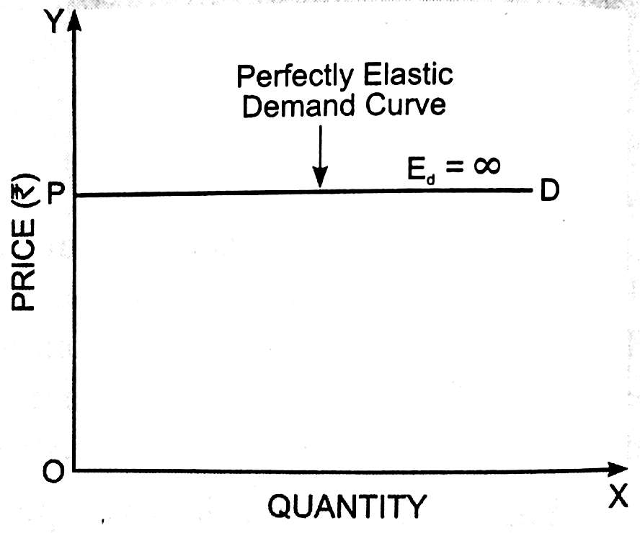
Perfectly Elastic Demand (Ed=∞)

Slide 10
Perfectly Inelastic Demand (Ed=0)
This is another exceptional case of price Ed.
If the price Ed for a good is perfectly inelastic, the demand does not change at all in response to any change in its price.
This is also known as zero Ed.
Such cases may be observed if the goods are extremely necessary or highly luxurious goods to be used by highly rich people.

Slide 11
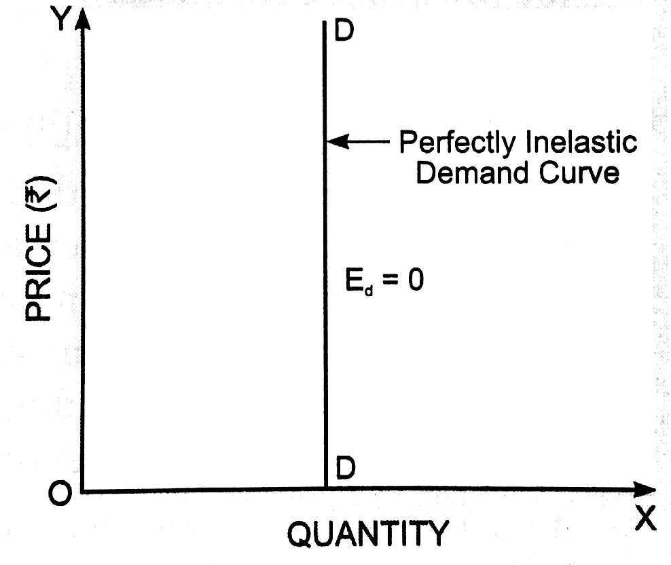
Perfectly Inelastic Demand (Ed=0)

Slide 12
Unitary Elastic Demand (Ed=1)
If the demand for a good shows Ed=1, then the % change in Q is equal to % change in P.
Conversely, if % change in Q is equal to % change in P, it represents a case of unitary price Ed.
In such cases the total expenditure (P*Q) on the good remains the same both in situation of increase or decrease in price of the good.
The shape of demand curve is rectangular hyperbola

Slide 13
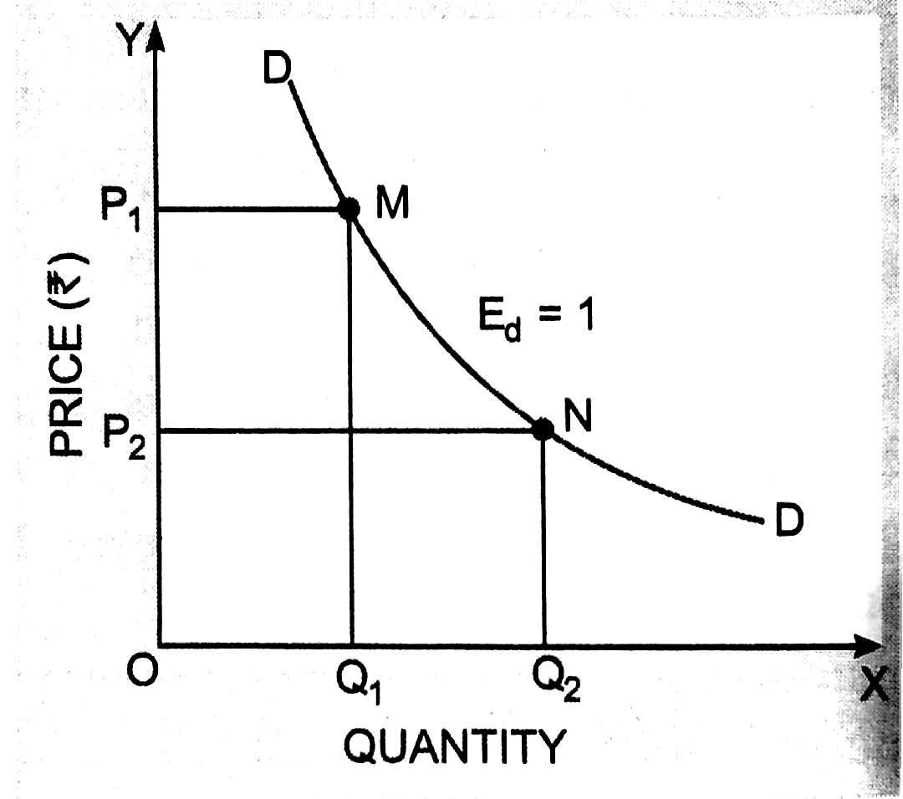
Unitary Elastic Demand (Ed=1)

Slide 14
Elastic or Greater than Unitary Elastic Demand (Ed>1)
It represents a situation in which % change in Q > % change in P.
The demand for the good is relatively more responsive to any change in its price.
If the price of such goods fall, the demand increases more than proportionately and vice-versa.
As a result, total expenditure on the good increases in case of fall in price and vice-versa.
The demand curve is relatively flatter in shape.

Slide 15
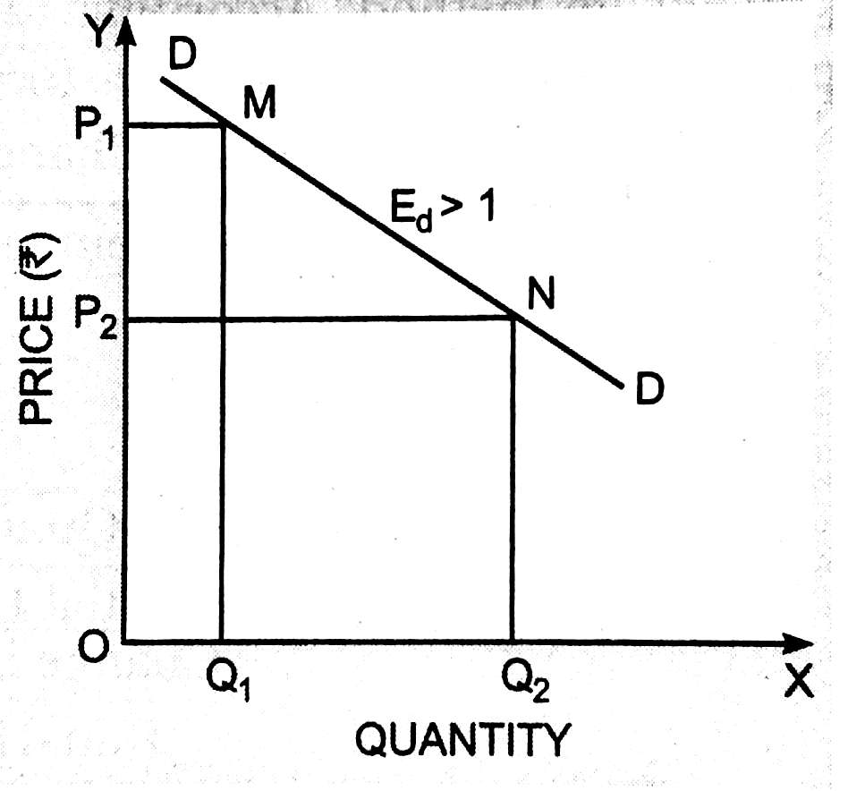
Elastic or Greater than Unitary Elastic Demand (Ed>1)

Slide 16
Elastic or Greater than Unitary Elastic Demand (Ed>1)
In the above diagram, when price is OP1, total expenditure is the area OP1MQ1.
When price falls to OP2, total expenditure becomes OP2NQ2.
Obviously, OP2NQ2 > OP1MQ1.
Thus, total expenditure increases in case of fall in price and vice-versa when price Ed > 1.

Slide 17
Inelastic or Less than Unitary Elastic Demand (Ed<1)
It represents a situation in which % change in Q < % change in P.
The demand for the good is relatively less responsive to any change in its price.
If the price of such goods fall, the demand increases less than proportionately and vice-versa.
As a result, total expenditure on the good falls in case of fall in price and vice-versa.
The demand curve is relatively steeper in shape.

Slide 18
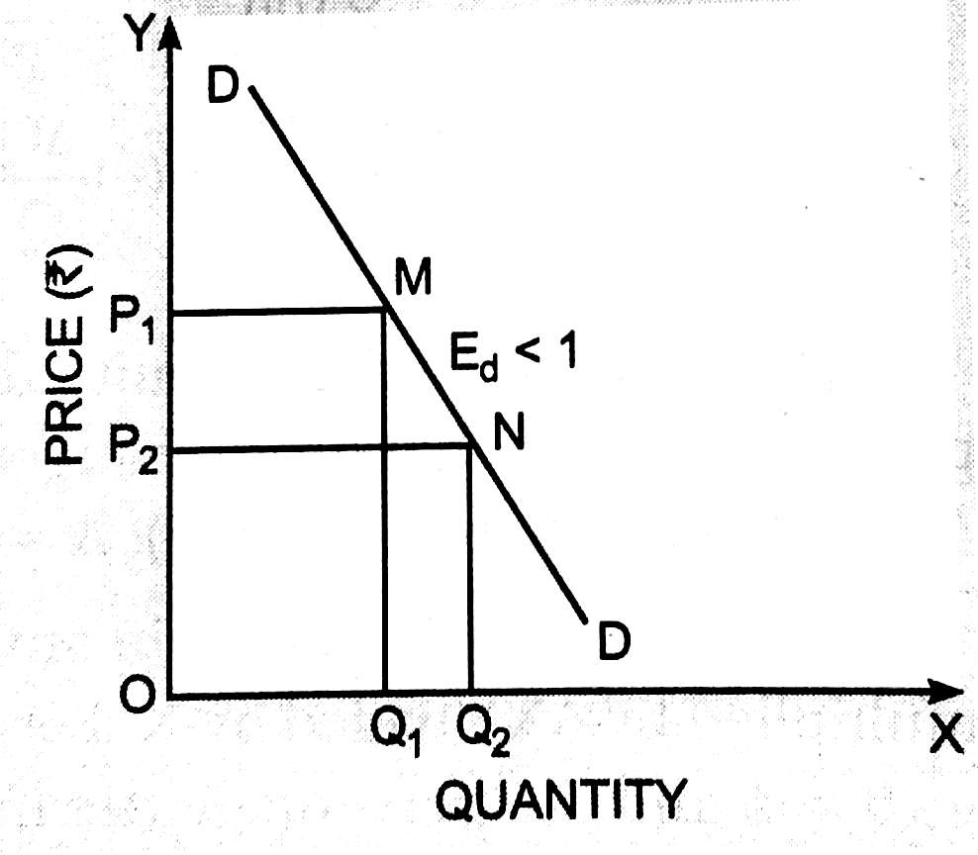
Inelastic or Less than Unitary Elastic Demand (Ed<1)

Slide 19
Inelastic or Less than Unitary Elastic Demand (Ed<1)
In the above diagram, when price is OP1, total expenditure is the area OP1MQ1.
When price falls to OP2, total expenditure becomes OP2NQ2.
Obviously, the area OP2NQ2 < the area OP1MQ1.
Thus, total expenditure (TE) decreases in case of fall in price and TE increases in case of rise in price, when price Ed < 1.

Slide 20
Measurement of Price Ed
Proportionate or Percentage Method
Point Method or Graphic Method
Total Expenditure Method
Arc Method – This is another Graphic Method and
Revenue Method

Slide 21
Measurement of Price Ed: Proportionate or Percentage Method
Ed=(∆Q/ ∆P)×(P/Q)
Or, Ed=(∆Q/ ∆P)×(P/Q)
The Price Ed may also be expressed as Ed=%∆Q/%∆P.
Where, %∆Q is given by (∆Q/Q)*100 and %∆P is given by (∆P/P)*100.

Slide 22
Point Method or Graphic Method
According to this method:
Ed can be measured on any point of a demand curve for an infinitesimally small change in price of a good.
Ed is different at different points of a given linear demand curve.
The simple formula to measure Ed on any point of the given demand curve is
Lower Segment/Upper segment of that point.

Slide 23
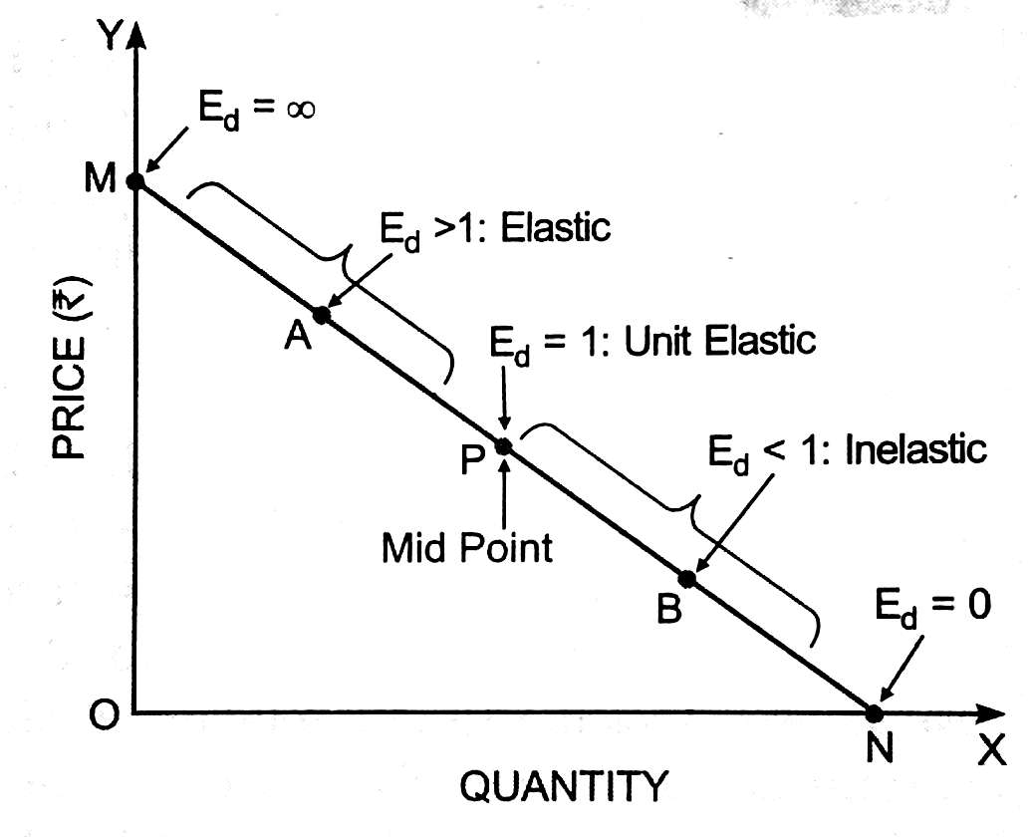
Point Method or Graphic Method

Slide 24
Point Method for a Non-linear Demand Curve
If Ed is to be measured for a non-linear demand curve then, a tangent is drawn along that point of the non-linear demand curve where Ed is to be measured.
Now the same formula i.e.
Lower Segment/Upper segment with respect to tangent line and not the non-linear demand curve is applied to measure Ed.
In the following diagram Ed at point P is PN/PM.

Slide 25
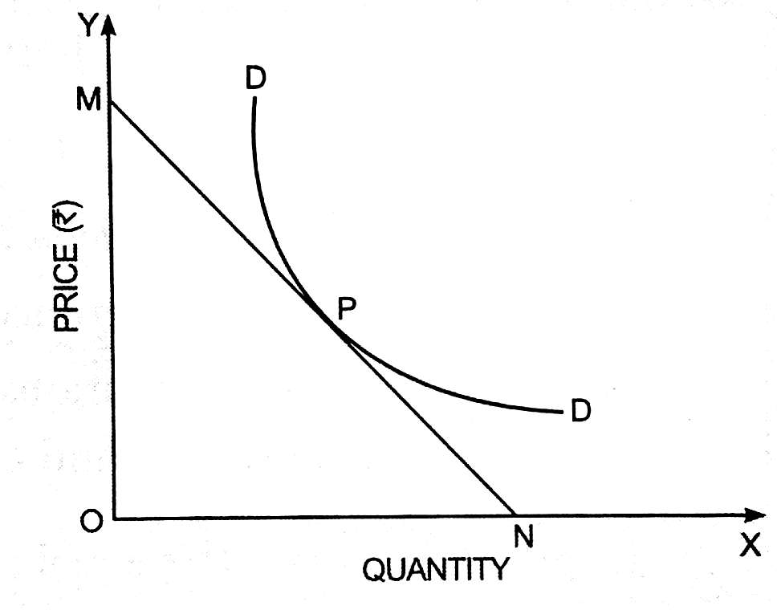
Point Method for a Non-linear Demand Curve

Slide 26
Total Expenditure Method
Total Expenditure (TE) Method to know the Ed was devised by Prof. Marshall.
He suggested that by observing the behaviour of TE the degree and direction of Ed can be established and the converse is also true.
In other words, if we know the value of Ed, we can predict the behaviour of TE to be incurred on a given good.
Thus, TE does not provide any precise measure of the Ed rather it provides a relationship between Ed and TE.

Slide 27
Total Expenditure Method
Three types of relationships between Ed and TE:
If Ed > 1, TE increases with a fall in P and TE decreases with a rise in P. The converse is also true. In other words, change in P and TE move in opposite directions.
If Ed < 1, TE increases with a rise in P and TE decreases with a fall in P. The converse is also true. In other words, change in P and TE move in same directions.
If Ed = 1, TE does not change whether P rises or falls.

Slide 28
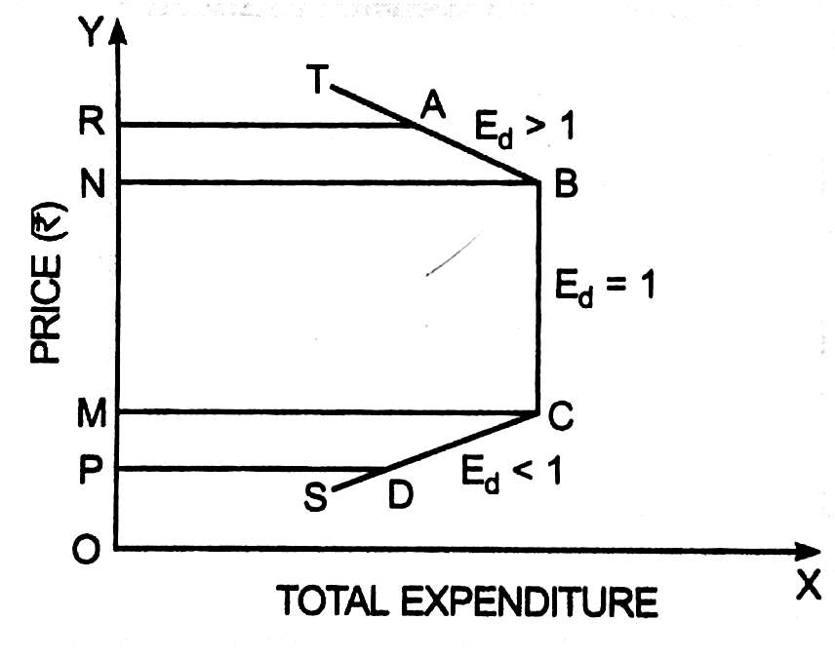
Total Expenditure Method: Diagram

Slide 29
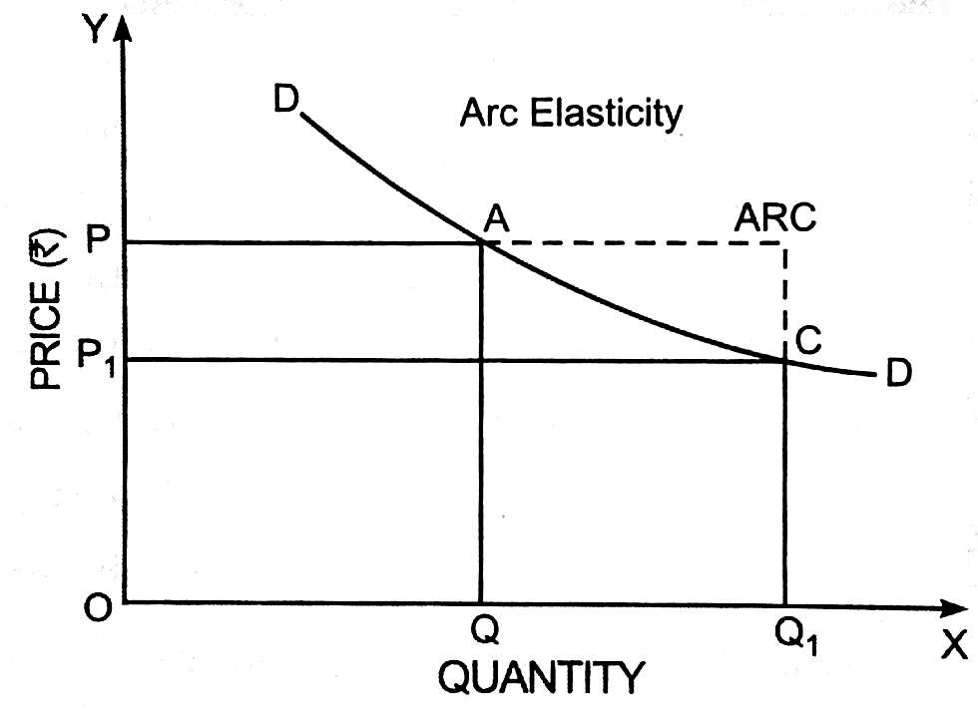
Arc Method

Slide 30
Arc Method Contd…
The point method of measuring price elasticity is useful when the dimension of change in price and quantity is very small.
When such changes are substantial Arc method is better.
In the above diagram the price Ed is measured between two points on the given demand curve i.e. AB.
Here, the average price and quantity is used to measure Ed.

Slide 31
Arc Method Contd…
Ed = (P1+P)/(Q1+Q)*∆Q/ ∆P
Where, ∆Q = Q1-Q and ∆P = P1-P
Revenue Method
Ed = AR/(AR-MR)
In the following diagram:
Ed at point P = PB/PA (Lower Segment/Upper Segment).

Slide 32
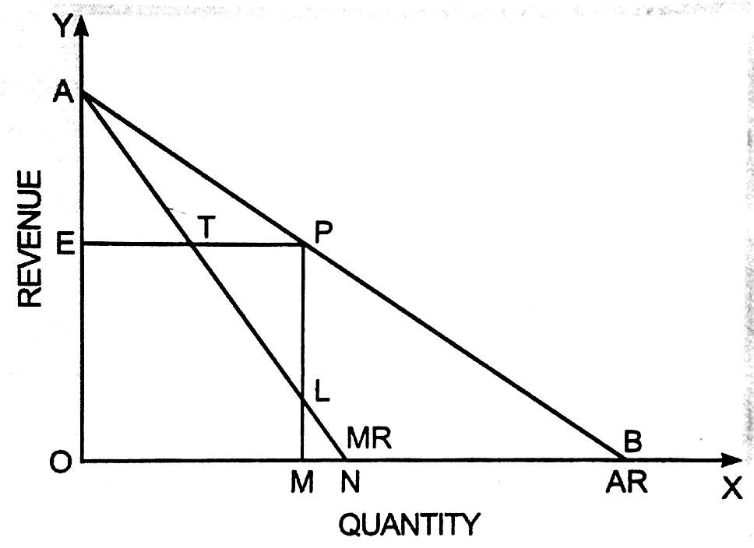
AR, MR and Ed

